Slide 1




PFAS containing technologies for the EU path to a climate neutral society based on the European Green Deal
Generation
Distribution
Final Use
Wind Power
Transmission &
Distribution Equipment
H₂-Production
E-Mobility
Industry
Buildings
Grid Access
Electric Energy
Storage
Fuel Cell
Heat Pump
Pumps
Electrical Contacts
Semiconductors
Electric Drives
Juli 2023
Cross-sectional Technologies

Slide 2



Wind Power
(onshore/offshore)
Grid Access
Products:
Wind turbine
Relevant for:
Renewable energy production
Function of product:
Production of electrical power by using natural wind
PFAS substance used:
PTFE (lubricant)
PFAS containing material / component:
taping foil moulds as release agent in production; sealing rings, gliding pads, lubricants, li-battery
Reason for use:
separates rotor blades from mould during production, smooth kinematic motions, self sustainable turbines application
Lifetime of product:
about 20 years
Lifetime of PFAS used:
depending on application
Products:
HV Power Converter
Relevant for:
Enabling grid access to connect renewable offshore power generation to the grid over longer distances
Function of product:
conversion of electric power from high voltage alternating current (AC) to high-voltage direct current (HVDC) for long distant power connections
PFAS substance used:
PVDF
PFAS containing material / component:
Cooling pipes (oil system)
Reason for use:
extrem heat- and high (aggressive) chemical resistance insulation ability, low water absorption and fire retarding ability
Lifetime of product:
30 – 40 years
Lifetime of PFAS used:
designed for product lifetime, can be easily separated for disposal

Slide 3


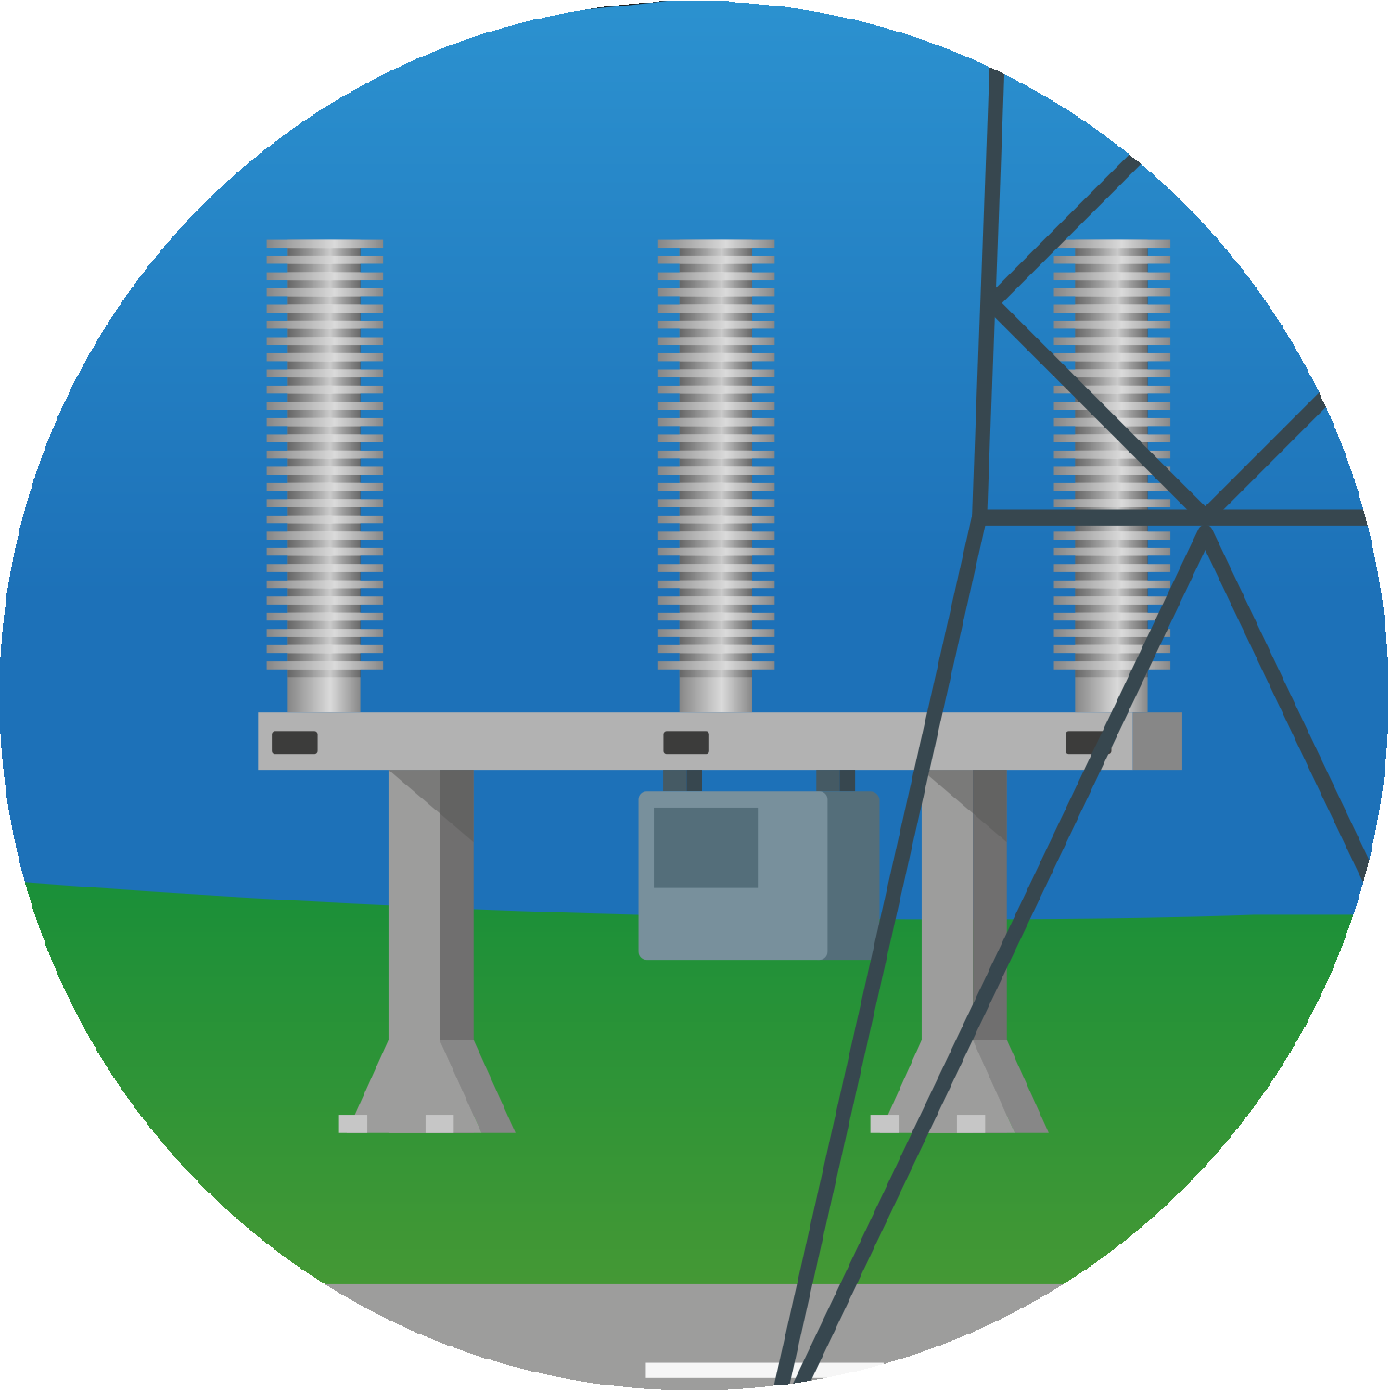
Transmission & Distribution Equipment
Electric Energy Storage
Products:
HV/MV switchgear; instrument transformer; Coils; Distribution and Power Transformer
Relevant for:
grid stability and security (risk prevention) - power overload protection for overhead and distribution lines; metering, protection and control of the high/medium voltage power system; power transformation
Function of product:
electrical switching in power T&D lines for industrial and commercial use, protection and controlling power loads; voltage or phase conversion HV to LV, electrical isolation, voltage measurement and monitoring in T&D lines
PFAS substance used:
solids: PTFE, PVDF, PFPE
lubricants: PTFE, insulating gases
PFAS containing material / component:
cooling pipes, seals; sliding ring, switching nozzle
Reason for use:
extreme heat-, flame- and high (aggressive) chemical resistance, low electric conductivity, dielectric insulation, low water absorption, ablation of PTFE for cooling purpose – prerequisite for arc switching, reduction of friction within kinematic chain, surface protection
Lifetime of product:
30 – 40 years
Lifetime of PFAS used:
Designed for product lifetime
Products:
Lithium-Ion Batteries
Relevant for:
Energy storage, electric mobility, ICT (information and communications technology), medical devices, tracking, smart metering, security devices
Function of product:
Storage and supply of electrical energy with low energy loss, high charging speed and energy density
PFAS substance used:
PTFE, PVDF
PFAS containing material / component:
low-molecular PFAS in electrolyte , binders in the cathode of lithium batteries
Reason for use:
intermediate electrical energy storage with minor losses and high charging cycles
Lifetime of product:
Up to 20 years
Lifetime of PFAS used:
designed for product lifetime

Slide 4
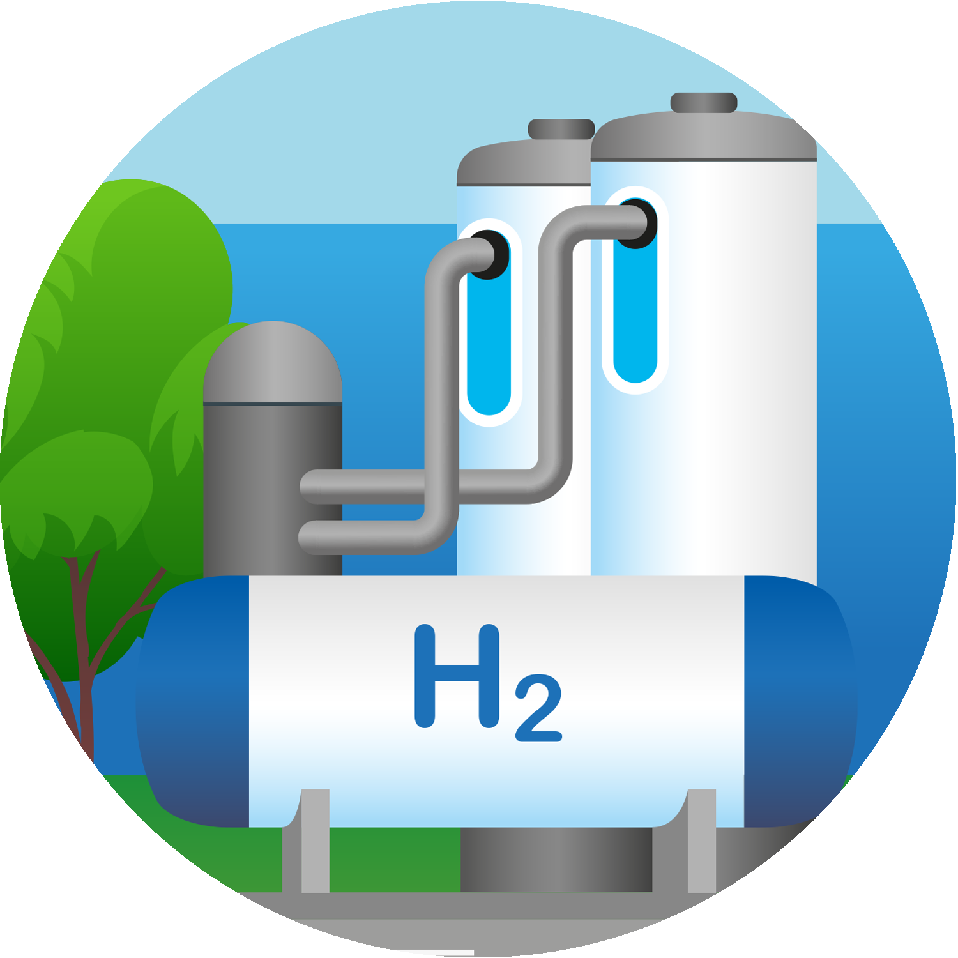
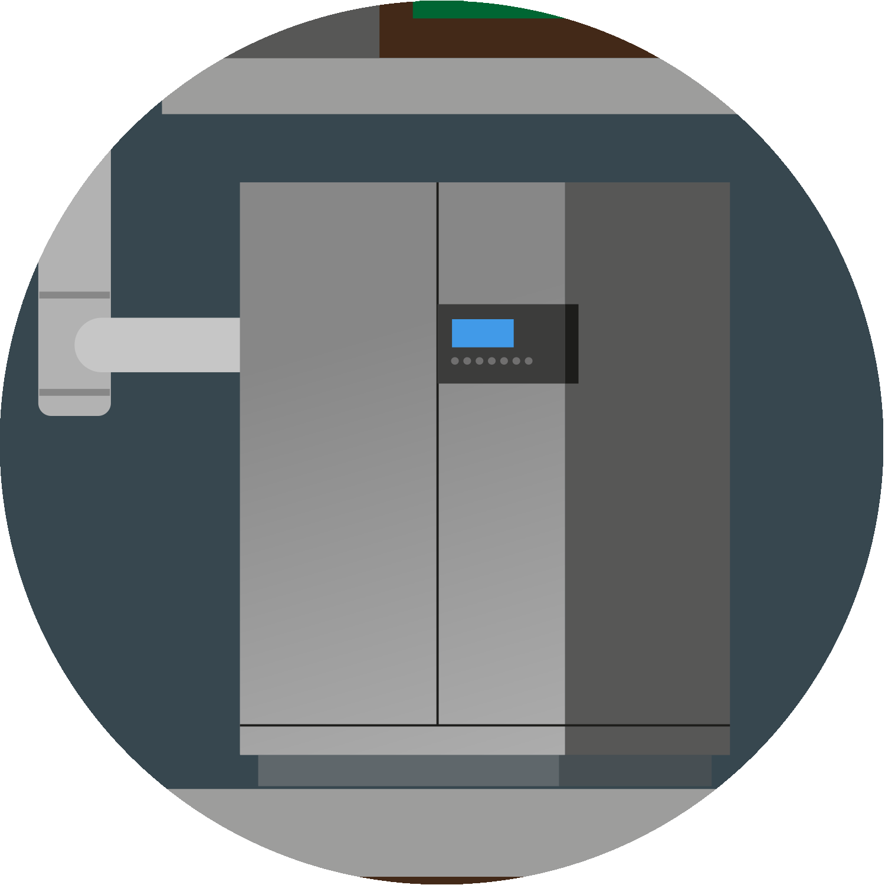
Hydrogen Production
Energy Storage
Products:
Electrolyzer
Relevant for:
renewable energy - production of green hydrogen by electrochemical splitting of water
Function of product:
electrochemical conversion of (green) electrical energy into chemical energy (hydrogen as an energy carrier). An electrolyzer catalytically splits water into oxygen ions and protons. Applying an electrical current protons migrate through a membrane and convert to H₂ at the cathode while O₂ forms at the anode.
PFAS substance used:
PFSA, PTFE , ePTFE, PFPE, PFA, and others
PFAS containing material / component:
membranes, GDL (gas diffusion layer), catalyst layer for MEA (membrane electrode assembly), sealings for stacks and other system components
Reason for use:
heat- and high (aggressive) chemical and mechanical resistance, wetting properties, low surface energy.
Lifetime of product:
~25 years, 10 years for electrolyzer stacks
Lifetime of PFAS used:
see product, PM catalyst recovery ensures full recycling
Products:
Fuel Cell
Relevant for:
renewable energy – efficient „re-electrification“ of hydrogen to electric power. Use of chemical energy for storage and fast refueling while having a higher efficiency than the combustion engine and no pollutant emissions.
Function of product:
electrochemical conversion of hydrogen into electricity and water
PFAS substance used:
PFSA, PTFE, ePTFE, PKM
PFAS containing material / component:
membrane, GDL (gas diffusion layer) for MEA, catalyst layer for MEA, Sealing for Bipolar plate and Cathode-/Anode endplate
Reason for use:
heat- and high (aggressive) chemical and mechanical resistance, wetting properties, low surface energy.
Lifetime of product:
~15 years, operating hours: 15.000 h, target: 30.000 h.
Lifetime of PFAS used:
see product, PM catalyst recovery ensures full recycling

Slide 5



Buildings
E-Mobility
Products:
Heat Pumps
Relevant for:
Energy transition, decarbonization, energy-efficient houses
Function of product:
provide heating, cooling and hot water for residential, commercial and industrial use
PFAS substance used:
PVDF, PTFE (solids) , PFA, FEP, FKM, ETFE, PP-TFE
PFAS containing material / component:
Refrigerants, sealings and insulation, electronics / controls and monitoring equipment, compressor (bearing, seals, electronics)
Reason for use:
High temperature-, aggressive chemical-and UV resistance, high dielectric strength, high refractive index, inherent flame retardance, moisture barrier, non-fouling behavior in water systems.
Lifetime of product:
average 15 – 20 years
Lifetime of PFAS used:
designed for product lifetime
Products:
Battery, drive, cooling system, actuators for management of cooling fluid cycles
Relevant for:
Battery electric vehicles (BEV) and its lifetime operation
Function of product:
see description of electrical storage and electric drives; drive train components (converter, e-engine, transmission) via high performance gearmotor actuators
PFAS substance used:
PFPE/PTFE containing lubricant, refrigerant R1234yf
PFAS containing material / component:
cooling refrigerant, lubricants in micro-gearboxes (actuators)
Reason for use:
resilience against temperature fluctuation, wear protection, functional precision, avoidance of significant weight increase and design challenges. Thermal management of BEV coolant cycles requires high precision actuation of gearmotor-driven valves and flaps over temperatures ranging from -40°C to +150°C.
Lifetime of product:
~up to 25 years.
Lifetime of PFAS used:
Same as vehicle lifetime

Slide 6

Industry
Products:
Combined heat and power plant for decentralized power and heat generation
Relevant for:
decentralized power and heat generation, power grid stabilization
Function of product:
conversion of chemical energy (e. g. hydrogen, see fuel cell technology) into electricity and heat
PFAS substance used:
PTFE (solid), PTFE lubricants, PFPE, insulating gases
PFAS containing material / component:
Seals, hoses, PTFE tape, hydraulic fluid, cables
Reason for use:
Prevents fluid leaks, increases longevity of products that reduces waste, fire prevention, heat, flame and high (aggressive) chemical resistance, low electrical conductivity, dielectric insulation, low water absorption, provide friction reduction.
Lifetime of product:
25 years
Lifetime of PFAS used:
designed for product lifetime

Slide 7


Cross-sectional Technologies
Cross-sectional Technologies
Products:
Pumps, Vacuum technology, Compressors (H₂, Biomethane)
Relevant for:
Production and conveying of basic chemicals (e.g. acid and leach); Conveying liquid H₂ ; Manufacturing of Solar cells, Compression and Transport of gaseous H₂, Bio-methan, gaseous chemicals
Function of product:
Transport of liquid or gaseous substances by applying pressure through mechanical means, also for storage
PFAS substance used:
FKM/FPM, PTFE
PFAS containing material / component:
Seals, sealing rings, guide rings, non-stick coatings, Labyrinth inserts, Lubricants, Sliding bushes, hoses, diaphragms (Diaphragm compr.)
Reason for use:
resistance against high heat and (aggressive) chemicals resistance
Lifetime of product:
30 years and more (e.g. pumps, vacuum pumps)
50 years and more (process gas compressors H₂)
Lifetime of PFAS used:
designed for product lifetime
Products:
Electric Drive
Relevant for:
Automotive and industrial applications
Function of product:
Convert electric energy into mechanical energy
PFAS substance used:
FKM/FPM, PTFE, PFPE
PFAS containing material / component:
Sealing, coating, lubricant, wire insulation, guide element
Reason for use:
Thermal resistance, chemical resistance (e.g. anticorrosion), wear resistance (at high speeds, high-pressure cleaning), non-stick properties, low friction, resistance to environmental influences (UV radiation, ozone), lubricant compatibility
Lifetime of product:
30 years and more
Lifetime of PFAS used:
Designed for highest durability, replacement of sealings in case of wear

Slide 8


Cross-sectional Technologies
Cross-sectional Technologies
Products:
Electrical contacts
Relevant for:
High performance industrial contacts with high mating cycles and high current densities; required e. g. for rail applications and BEV contacts to withstand vibration stress during operation
Function of product:
Electrical high current transmission
PFAS substance used:
PFPE formulated grease or oil
PFAS containing material / component:
PFPE surface lubricant on metal contacts
Reason for use:
only PFPE based lubricants withstand the rough environmental conditions at the extreme temperatures at high current densities, reduction of mechanical friction, prevention of contact corrosion and
microwelding, reduction of electrical contact resistance
Lifetime of product:
Up to 25 years
Lifetime of PFAS used:
designed for product lifetime
Products:
Semiconductor (focus manufacturing process)
Relevant for:
electrification and digitalization in almost all technical applications
Function of product:
electrical power control and electrical information distribution switching
PFAS substance used:
PFPE, PTFE and other PFAS formulations (CF₄, C₄F₈,…)
PFAS containing material / component:
manufacturing process gases for plasma dry etching; chemical solutions for wet etching and wafer cleaning; additives in lithography materials; anti-stiction coatings; machinery for semiconductor processing
Reason for use:
low particle levels (due to low surface adhesion and low wear), chemical process requirements, thermal stability, optical properties
Lifetime of product:
lifetime of final product/facility
Lifetime of PFAS used:
n.a.; generally only used for manufacturing

Slide 9
Disclaimer
The topics take into account the state of the art at the time of issue.
Everyone is requested, if he encounters inaccuracies or the possibility of misunderstanding in the document, to notify the associations immediately so that any deficiencies can be corrected.
The addition of and linking to other content requires the agreement of the authors.
Contact
Kirsten Metz
ZVEI
Kirsten.Metz@zvei.org
Michael Püschner
VDA
Michael.Pueschner@vda.de
Alena Knauz
VDMA
Alena.Knauz@vdma.org

